Slide 1

Detection of Anomaly Using Graph Fairing Convolutional Networks
Students
Omri Sharof
Boris Shoostin
Supervisors
Prof. Zeev Volkovich
Dr. Renata Avros
24-2-R-6

Slide 2
Problem Definition: Anomalies In Scientific Citations
Problem
Purpose
Purpose
Scientific citation may be counterfeit (citation manipulation, misleading quotes), undermining the credibility of the research.
Detecting such anomalies citations in graph-structured data, where nodes represent papers and edges represent citations.
The project aims to propose a method to efficiently recognize citation anomalies

Slide 3
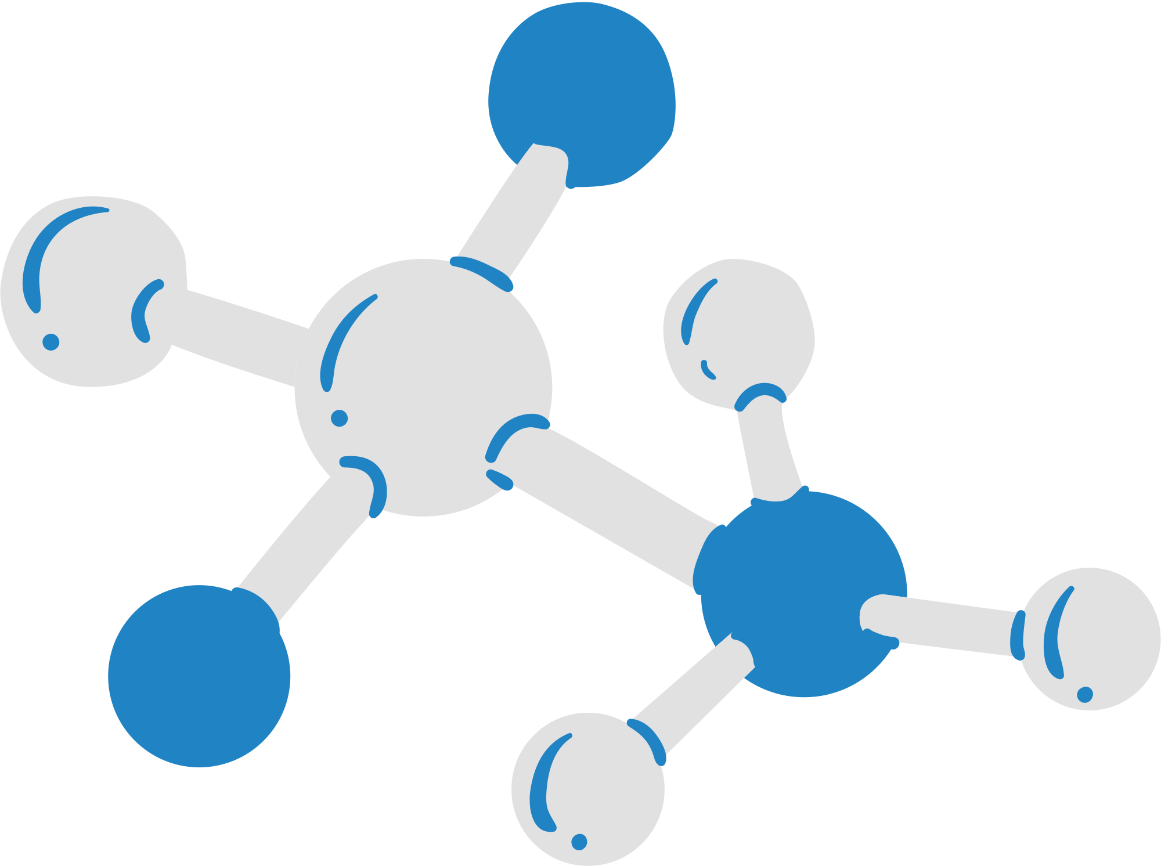

Approach Overview
Solution
Objective is to apply Graph Fairing Convolutional Networks (GFCNs) to model and analyze citation relationships within scientific literature.
Methods
Node2Vec, Isolation Forest, GFCN, Jacobi Method.

Slide 4
Graph Fairing Convolutional Networks (GFCN)
GFCN uses a multi-layer architecture, together with skip connections, and non-linear activation functions to extract high-order information of graphs as discriminative features.
Graph Fairing
Graph Convolution
Skip Connections
The core idea behind graph fairing is to smooth node features(or signals) on the graph by attenuating high-frequency noise and preserving the essential graph structure
This operation aggregates each node’s information from its neighbor nodes, analogous to how a pixel in convolutional neural network (CNN) aggregates information.
Allow the network to reuse initial node features at each layer, which helps stabilize training and retain important information across layers.

Slide 5
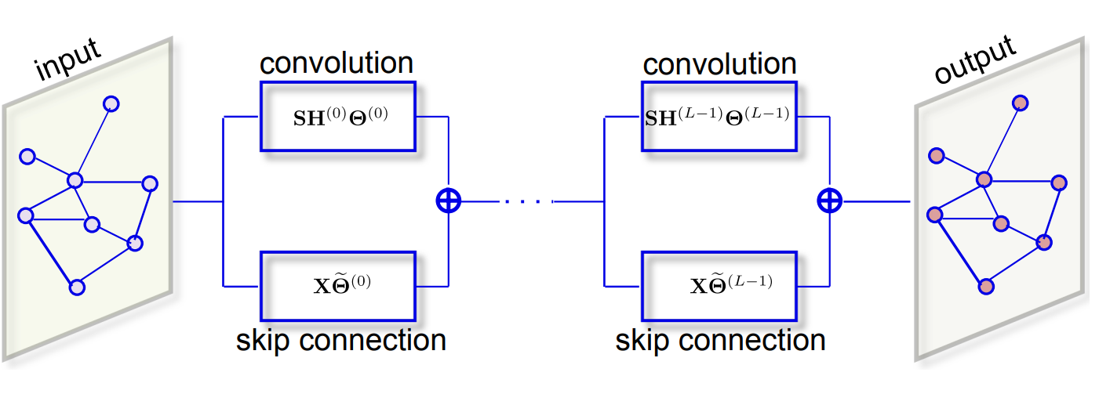
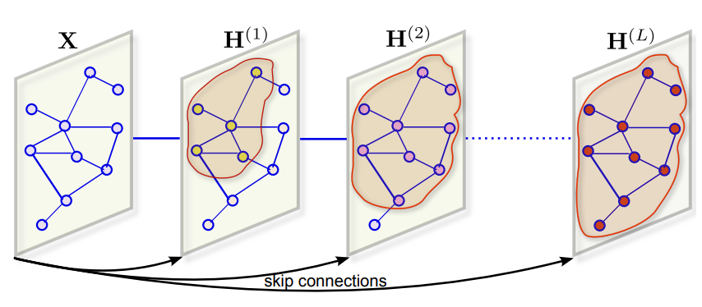
Convolution and Skip Connection Illustration
GFCN uses a skip connection to combine both the initial node representations and the aggregated node neighborhood representation enabling it to memorize information across distant nodes.

Slide 6

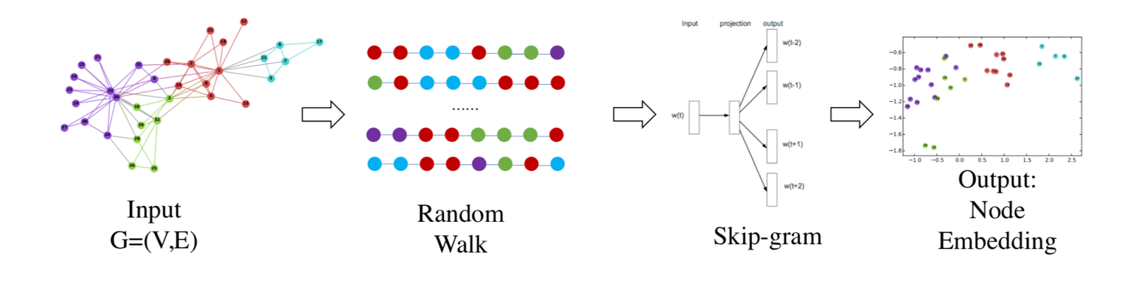
Node2Vec: Graph Embedding Technique
Node2Vec is an approach intended for constructing an embedding of a given graph to Euclidian space.
Node2Vec starts by generating random walks within the graph, like a random path that starts at a node and traverses the graph by randomly choosing neighboring nodes to visit.
As these random walks progress, they create sequences of nodes. Each sequence represents a unique path through the graph.
Node2Vec treats these node sequences as if they were sentences in natural language. It applies techniques from word embedding models like Word2Vec, such as the Skip-gram model or Continuous Bag of Words CBOW).

Slide 7


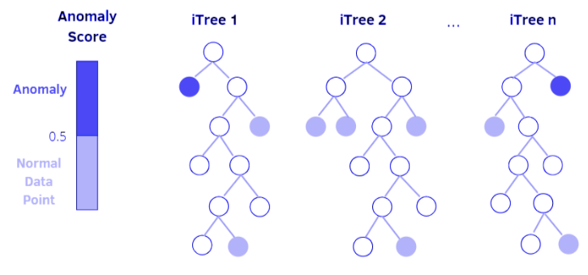
Isolation Forest for Anomaly Detection
Isolation Forest separates anomalies by randomly portioning data points.
Tree-based structure: Isolation Forest builds multiple random decision trees (iTrees).
Points isolated with shorter path lengths are more likely to be anomalies.
Random Partitioning: Each iTree randomly selects an attribute and splits the data, creating a hierarchy of partitions. Anomalies require fewer partitions to be isolated.
Anomaly Score: The algorithm assigns an anomaly score based on the average path length of the point across all iTrees. Shorter paths indicate a higher anomaly likelihood.

Slide 8
Sequence Diagram
Isdadsadsadsadsa

Slide 9
Model’s Process
Input dataset is fed into Node2Vec to generate node embeddings for the dataset.
The generated node embeddings are then passed into Isolation Forest to find Initial anomalies.
The result is 2 types of nodes that are then fed into a Graph Fairing Convolutional Network
The nodes classified as anomalies are then removed from the dataset.
We repeat the Isolation Forest & GFCN step K times.

Slide 10
Model’s Process
Generating Embeddings
N Iteration
Dataset Insertion
Node2Vec
Isolation Forest
GFCN
Results
Removal of detected Anomalies
“Graph”
Random Tree Construction
Apply Graph Convolution
Random Walks
Anomaly Scoring
Skip Connection
Skip Grams
Scored Dataset
Implicit Fairing
Node Embedding
Initial Anomalies
Anomaly Detection
The process makes it possible to review a nested anomalies structure

Slide 11
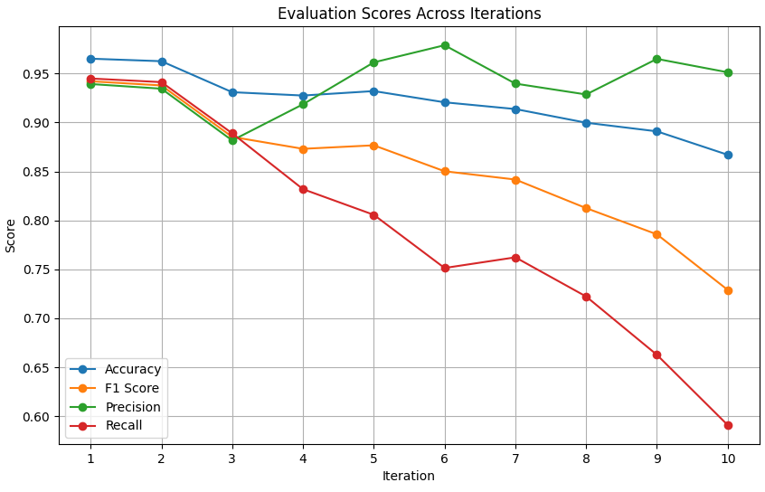
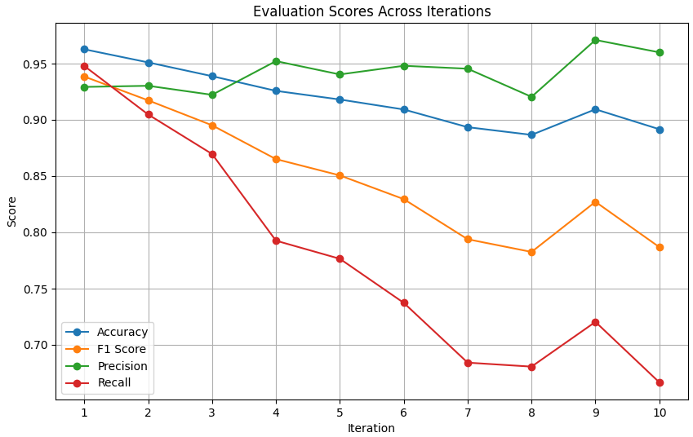
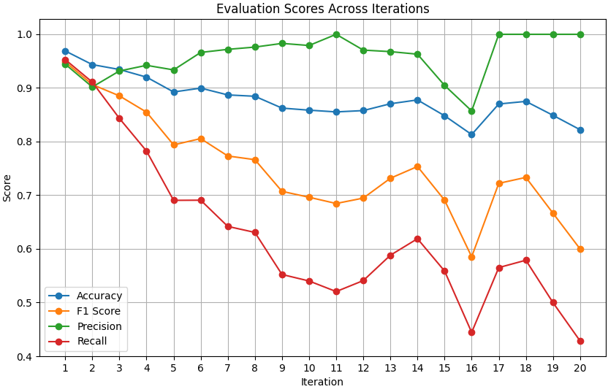
Results for CiteSeer data
CiteSeer Results with different hyperparameters, K = number of iteration
k = 10, num_of_trees = 50
k = 10, num_of_trees = 150
k = 20, num_of_trees = 150
Notes:
Make sure to explain what each score means briefly
Mention different data structures between datasets

Slide 12
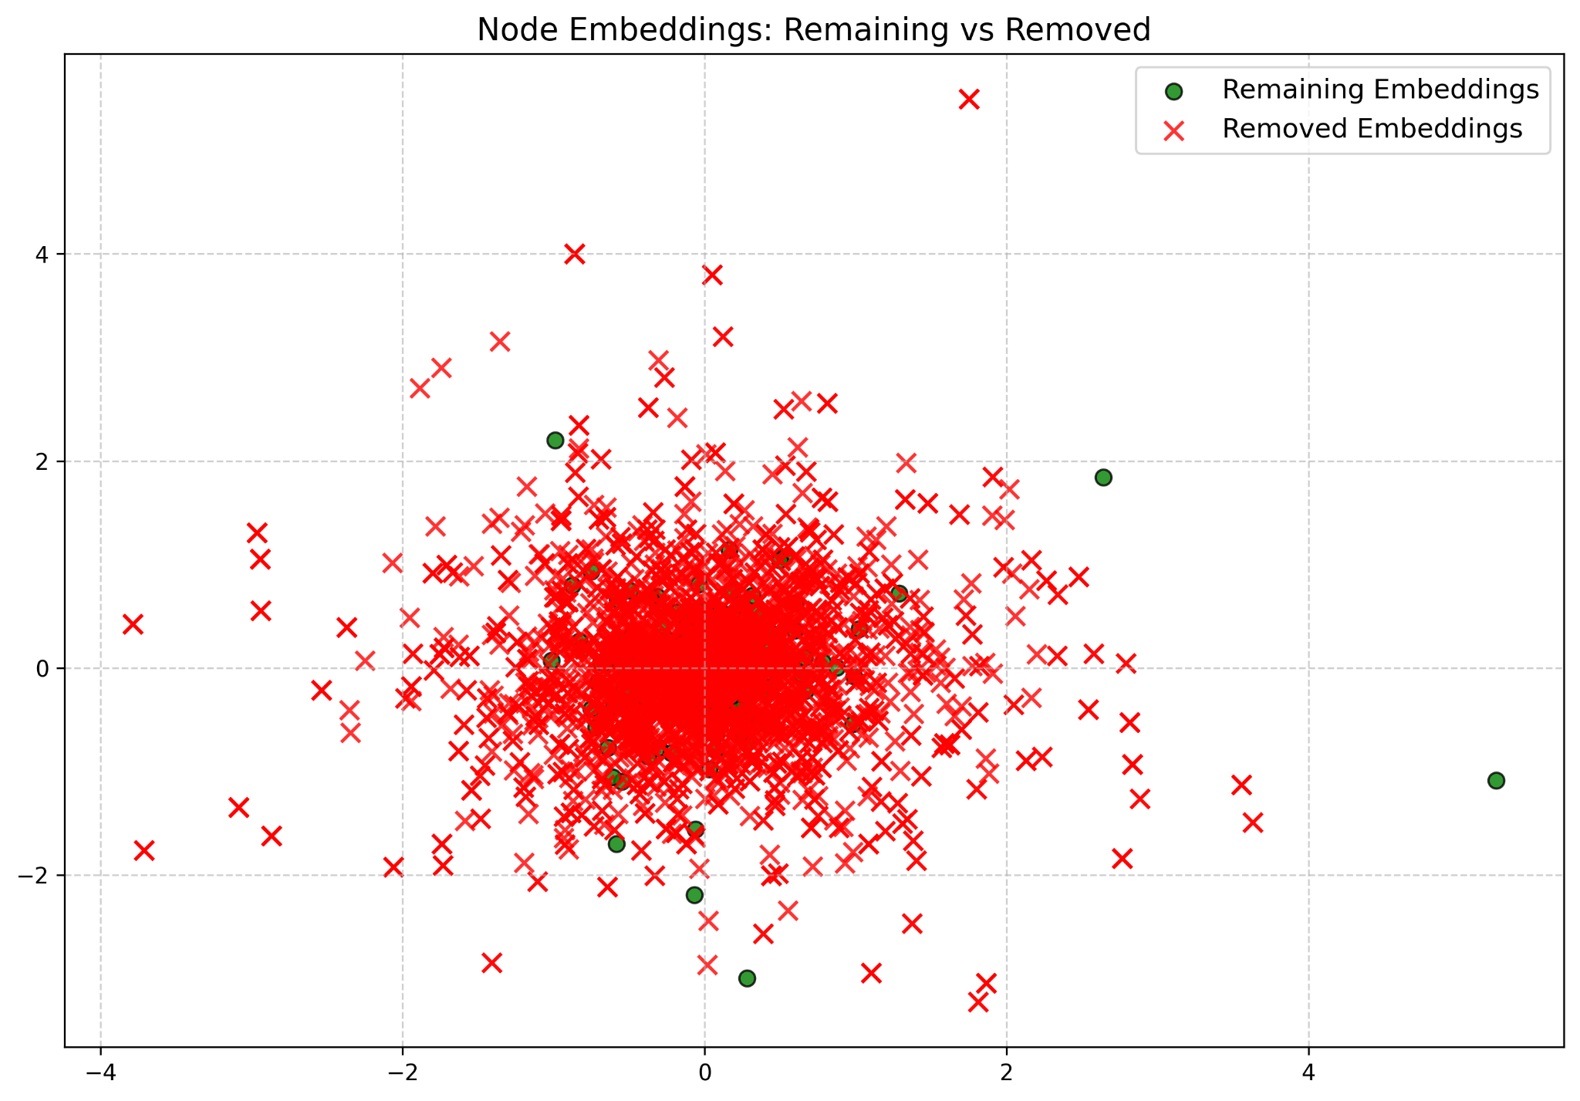
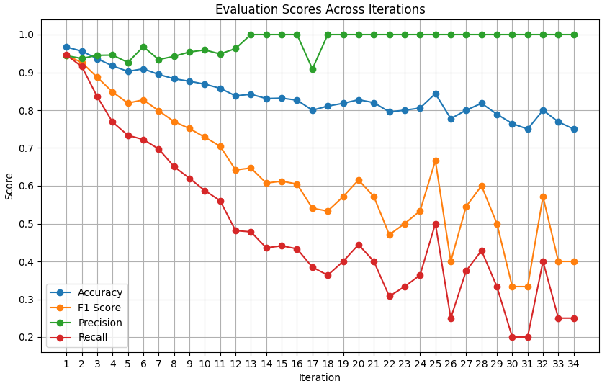
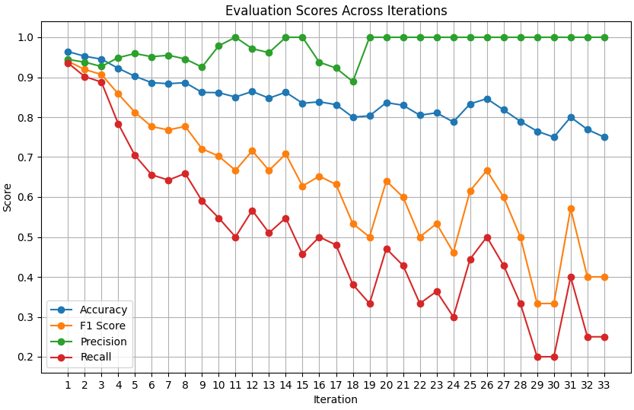
Results for CiteSeer data
CiteSeer Results with different hyperparameters, K = number of iteration
k = 50, num_of_trees = 150
k = 50, num_of_trees = 50
Notes:
Make sure to explain what each score means briefly
Mention different data structures between datasets

Slide 13
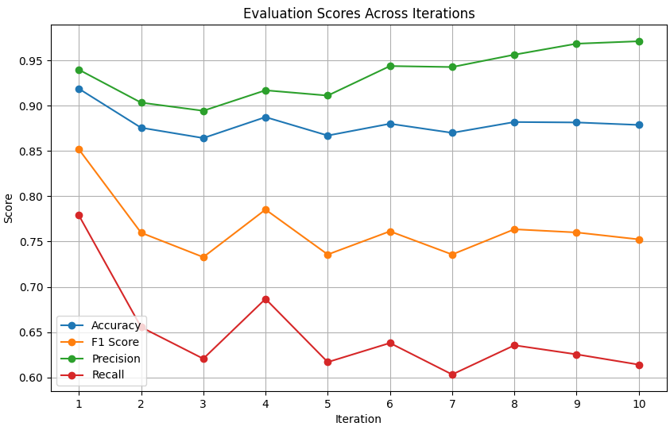
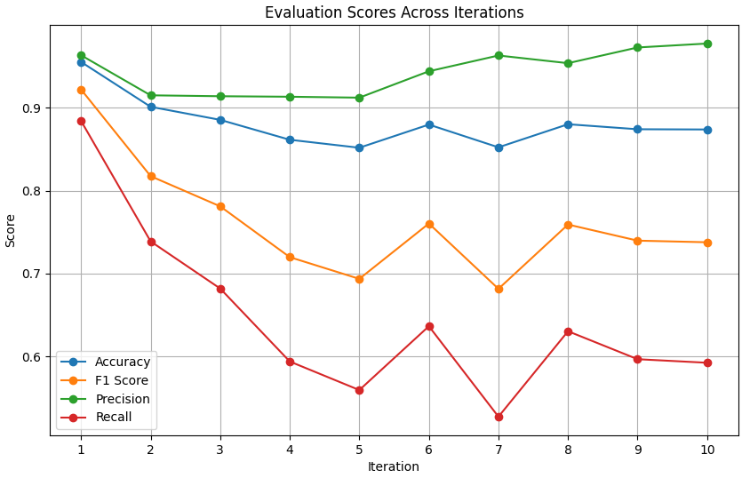
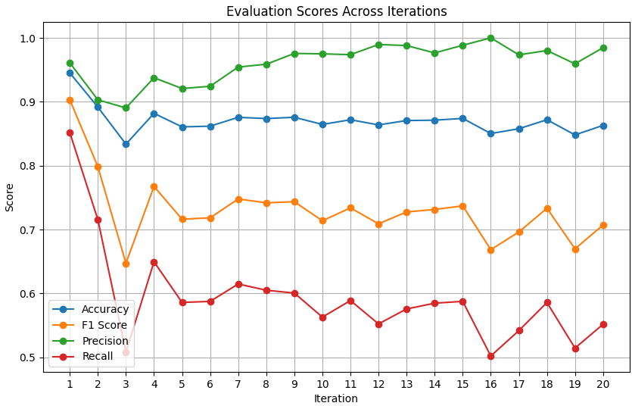
Results for Cora data
Cora Results with different hyperparameters, K = number of iteration
k = 10, num_of_trees = 50
k = 10, num_of_trees = 150
k = 20, num_of_trees = 150
Notes:
PubMed similar to Cora

Slide 14
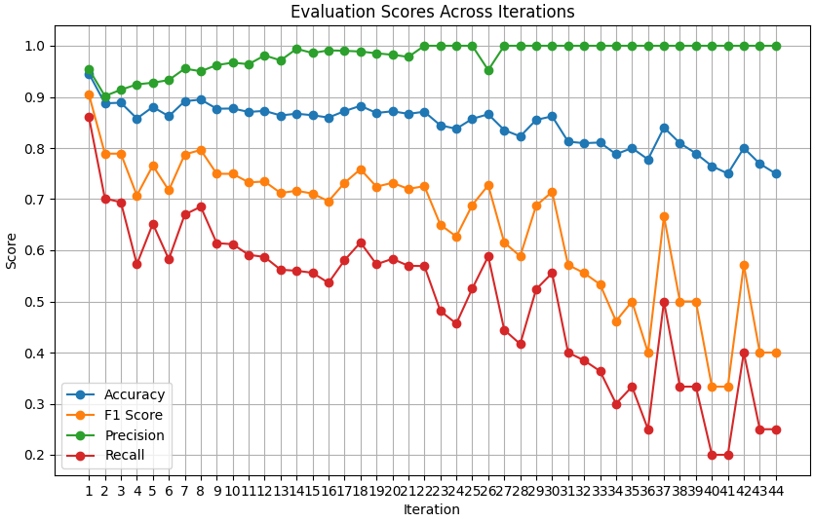
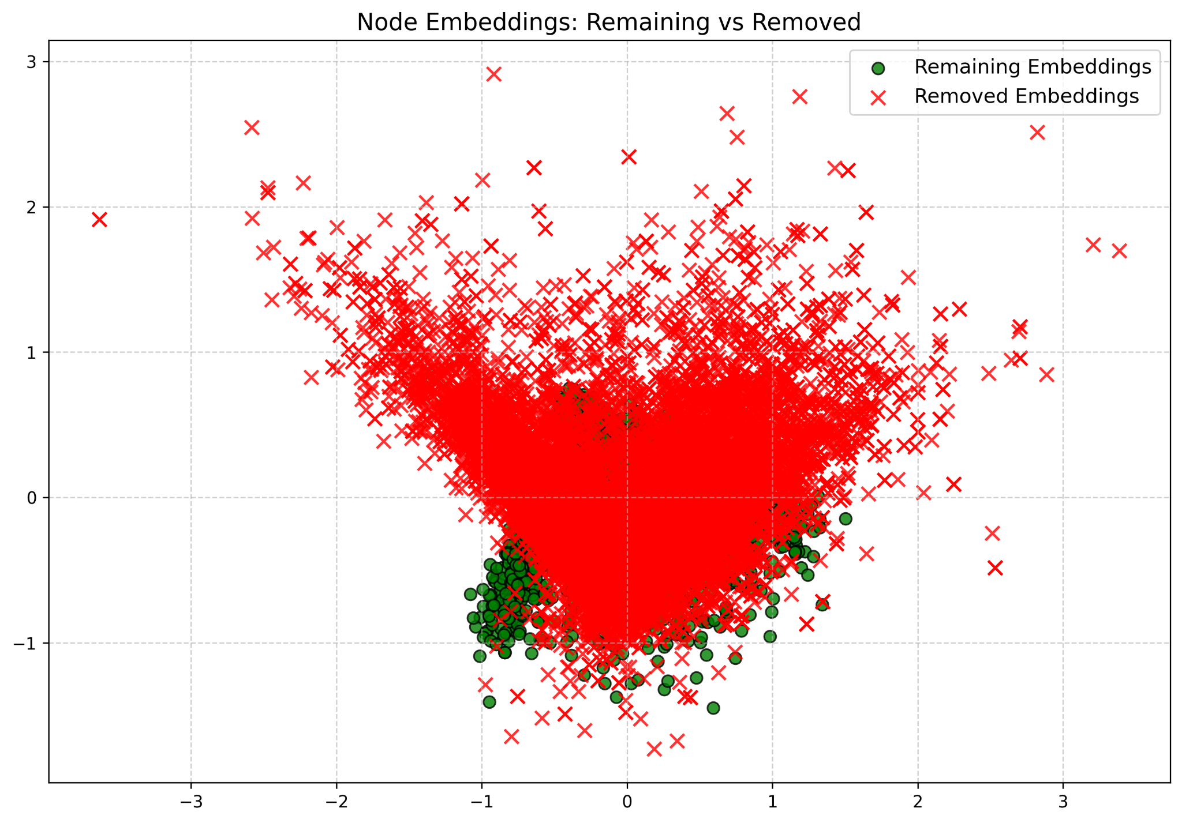
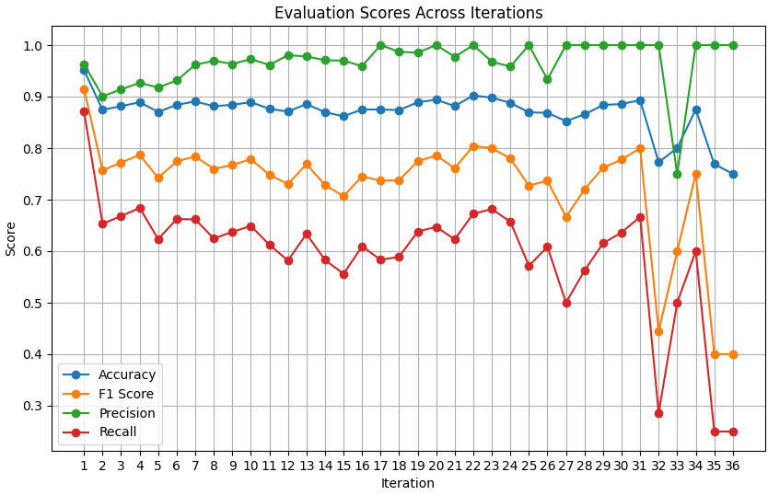
Results for Cora data
Cora Results with different hyperparameters, K = number of iteration
k = 10, num_of_tres = 50
k = 20, num_of_trees = 150
k = 50, num_of_trees = 150
k = 50, num_of_trees = 50
Notes:
PubMed similar to Cora

Slide 15
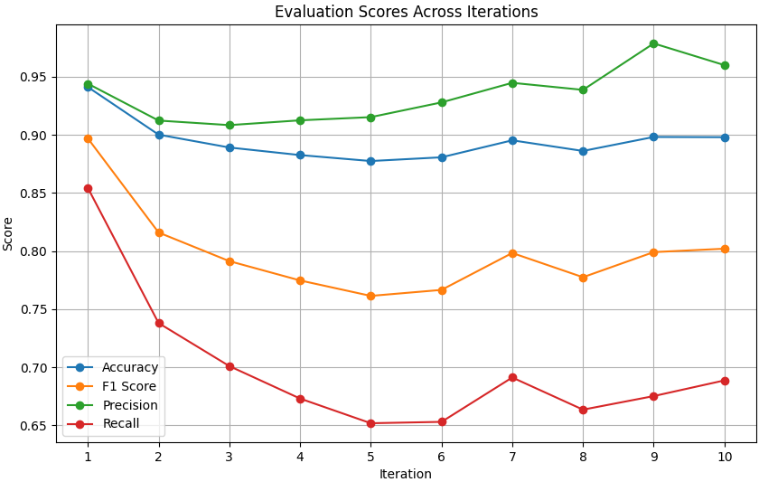
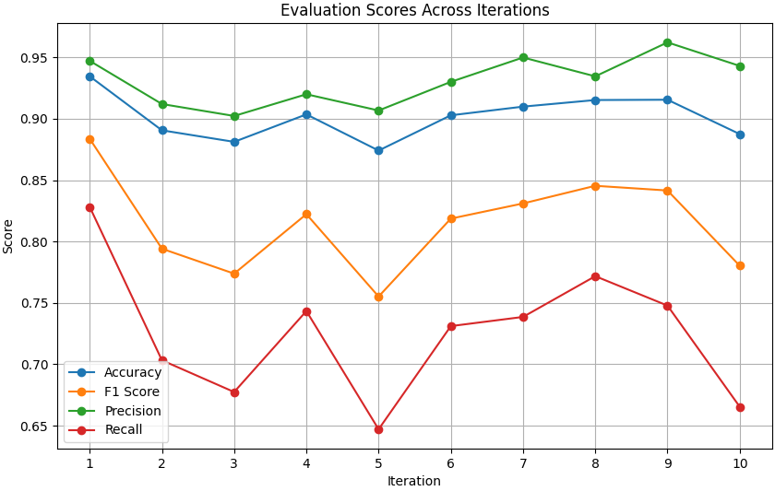
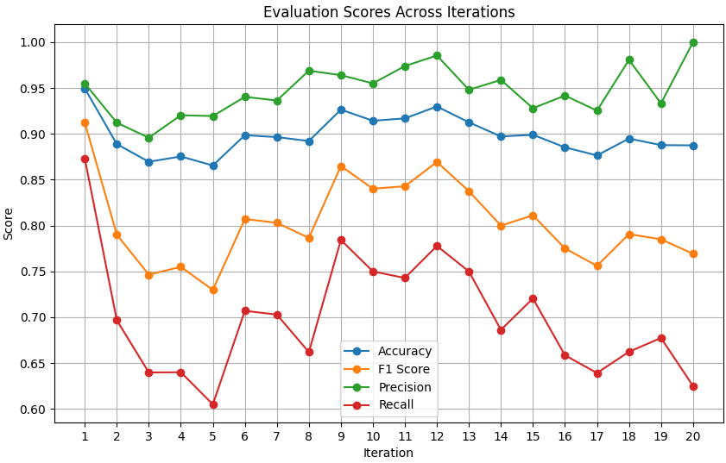
Results for PubMed data
PubMed Results with different hyperparameters, K = number of iteration
k = 10, num_of_trees = 50
k = 10, num_of_trees = 150
k = 20, num_of_trees = 150
Notes:
PubMed similar to Cora

Slide 16
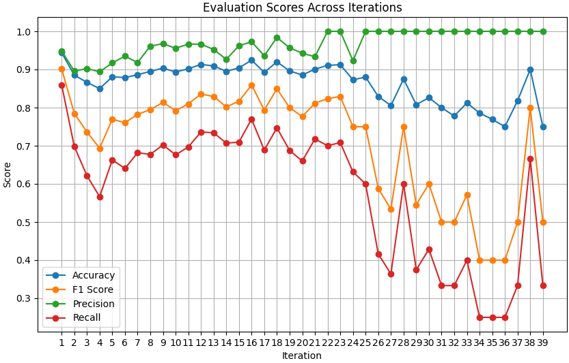
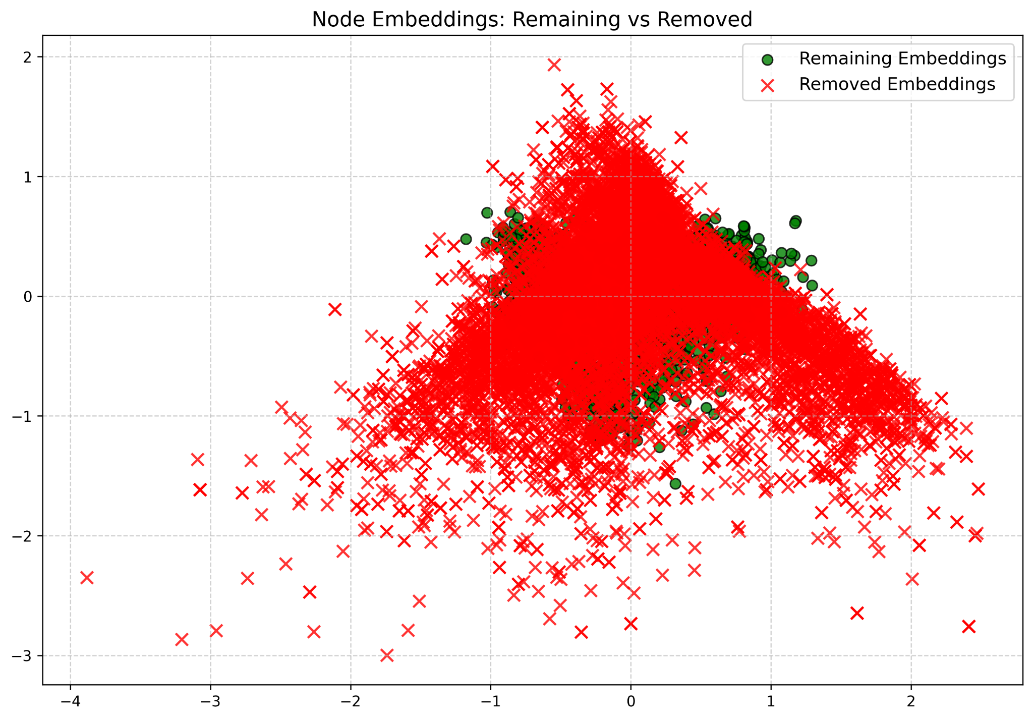
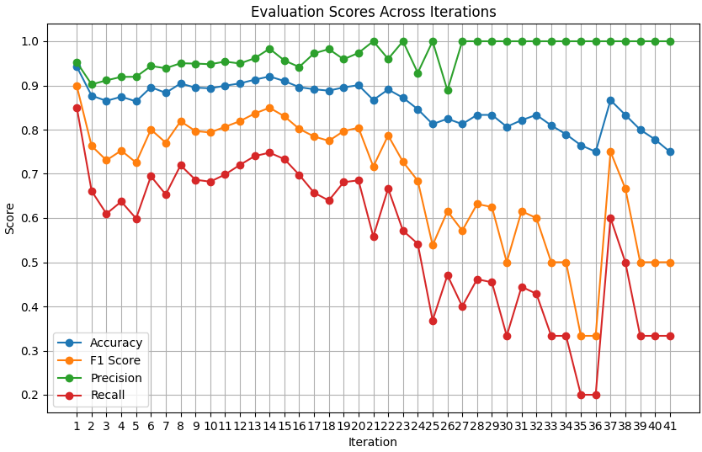
Results for PubMed data
PubMed Results with different hyperparameters, K = number of iteration
k = 50, num_of_trees = 150
k = 50, num_of_trees = 50
Notes:
PubMed similar to Cora

Slide 17
Testing and Evaluation Plan
Case | Test Case | Result
Node2Vec q & p suited values | Run Node2Vec on a sample graph dataset with q = 0.25 and p = 0.5 | Reached valid node embeddings as desired.
Isolation Forest Detection | Assess how varying the number of trees affects anomaly detection performance when n_estimators = 150 | Anomalies identified successfully and tagged in a csv file
Scalability with Large Dataset | A large citation graph dataset with over 5000 nodes and edges | The entire pipleline runs successfully and efficiently, achieving desired results
Evaluation Metrics | Detection against ground truth | Precision = 0.94, Recall = 0.8
GFCN Integration | Entered Results From Isolation Forest Into GFCN | GFCN trains and outputs node classification successfully

Slide 18
THANK YOU

